Slide 1

Say No To Plastic… Lets Go Elastic
Krishna Deepak Chamana Founder of KDSSG

Slide 2







About Me…
I am not a SQL DBA anymore…
I am a Azure Cloud SQL DBA
Traditional Introduction:
16 Years of experience with SQL Server Platform which includes Database, Windows & Virtualization, PowerShell and Azure.
Skills:
HA/DR Designing and Implementation, Performance Tuning/Optimization, Advanced Backup and Recovery, Azure and PowerShell.
When not with SQL Server, I love to be at Gym (my wife is my personal trainer).
When not at Gym, I would mostly be playing Xbox (or) Watching TV (or) at a nearby Cinema Hall.
In Short
Wife
Kids

Slide 3


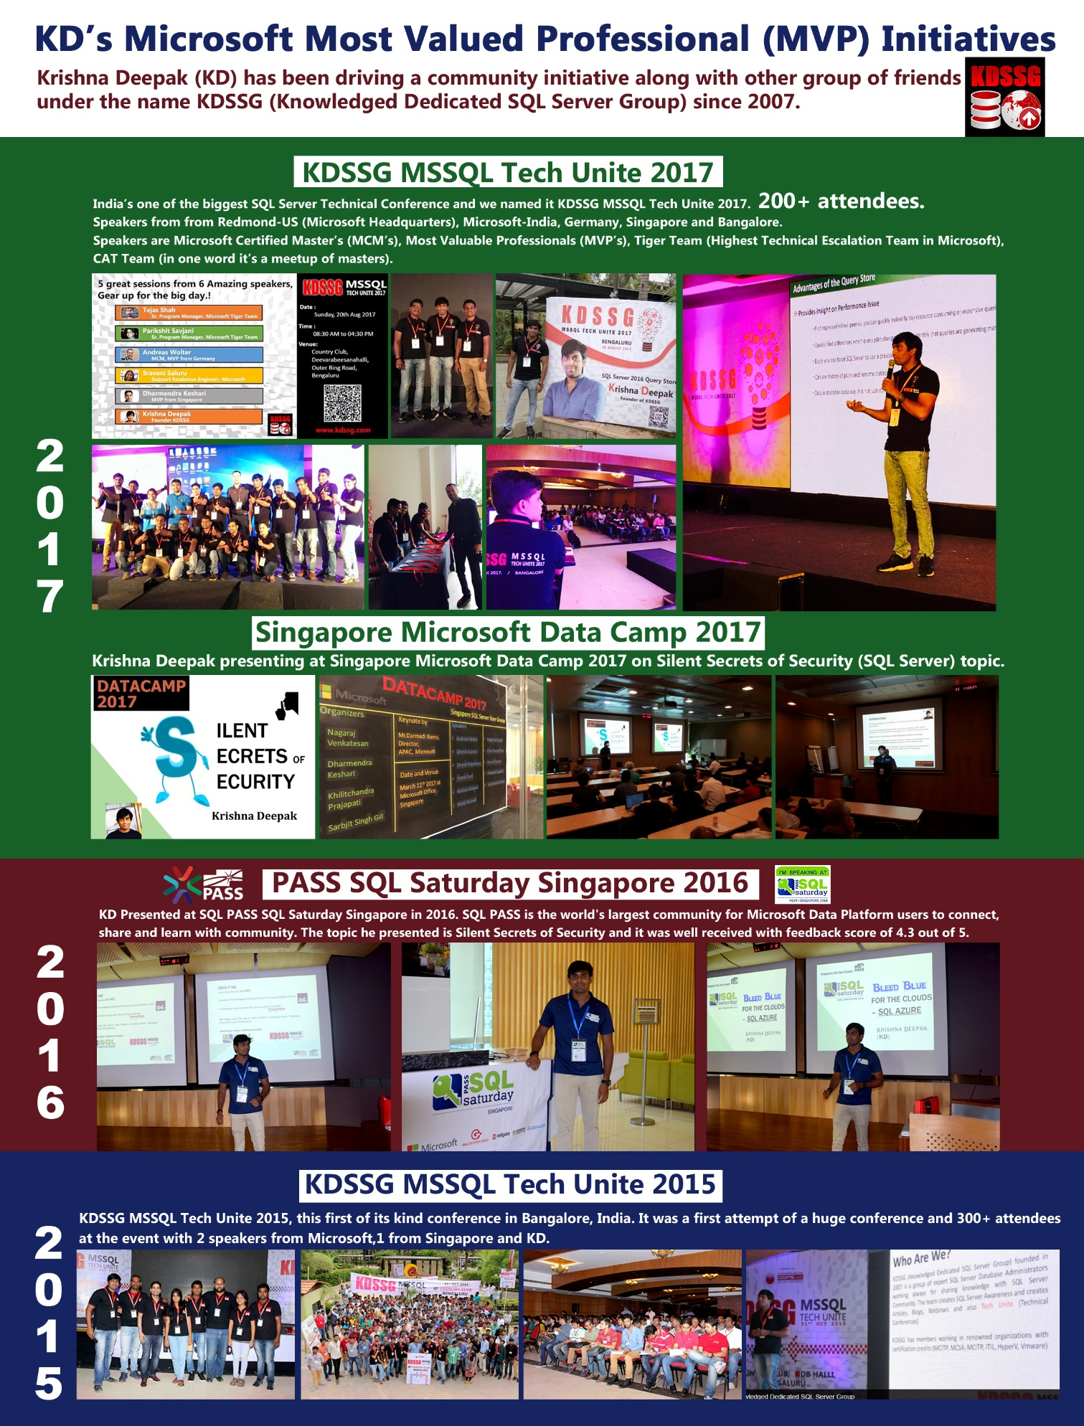
My Community Initiatives since 2015

Slide 4


Say No To Plastics…

Slide 5



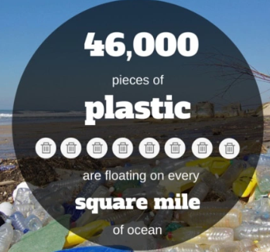

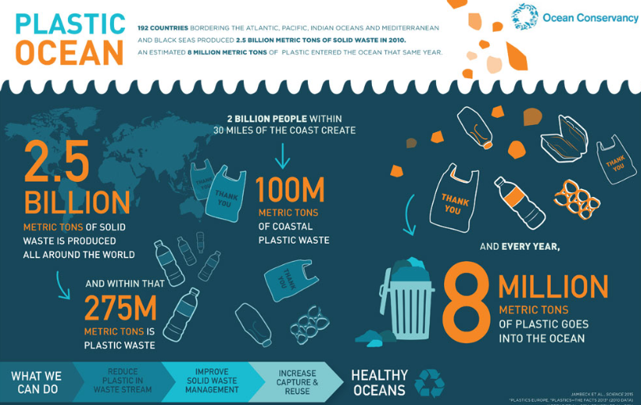

PLEASE Say No To Plastic… It’s Killing The World…

Slide 6

Two Main Problems… Pollution & Illusion…
Pollution
Illusion

Slide 7
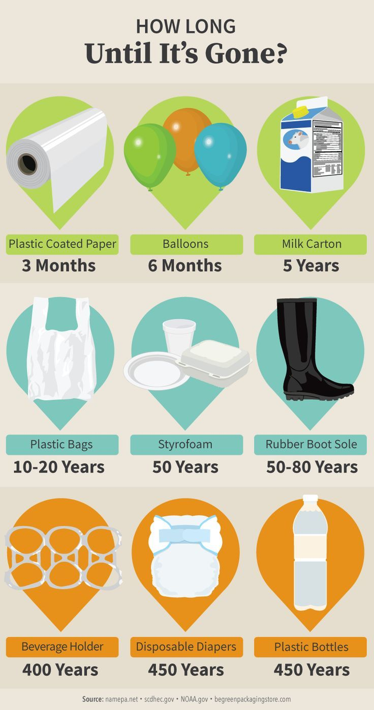
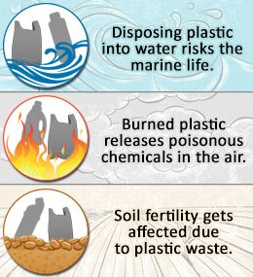
Two Main Problems…Impact

Slide 8

Pollution & Illusion… How to Solve Reduce them…

Slide 9
My Actual Topic… Lets Go Elastic… Elasticity in SQL Azure
Elastic Pools
Elastic Jobs
Elastic Queries
Elastic Pool is a collection of Azure SQL databases grouped together for saving cost.
Elastic Database Jobs helps run one or more T-SQL scripts in parallel across large number of DB’s.
Elastic Queries allows to perform cross-database queries to access remote tables.
Before talking further on Elasticity a quick 5 mins walk through on Azure SQL Databases.

Slide 10
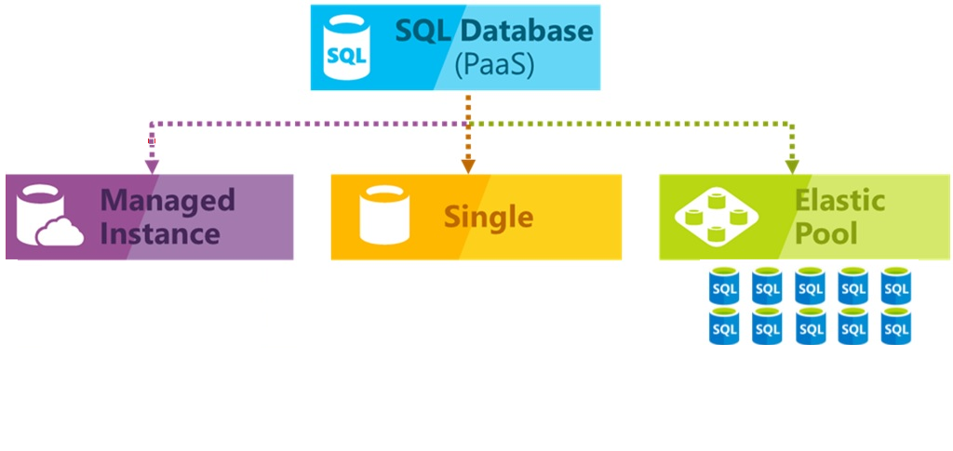
Azure SQL Databases (5 minutes walk through)

Slide 11

Azure SQL Databases

Slide 12

Azure Elastic Pool
SQL Database elastic pools are simple, cost-effective solution for managing and scaling multiple databases that have varying and unpredictable usage demands.
The databases in an elastic pool are on a single Azure SQL Database server and share a set number of resources at a set price.
A common application pattern is to provision a single database for each customer. But different customers have different
varying and unpredictable usage patterns, and it is difficult to predict resource requirements of each individual DB user.
Two Challenges are
Over provision resources based on peak usage and pay more
Under provision to save cost, but it may lead to performance issues for the database during high loads
Elastic pools solve this problem by ensuring that databases get the performance resources they need when they need it.

Slide 13
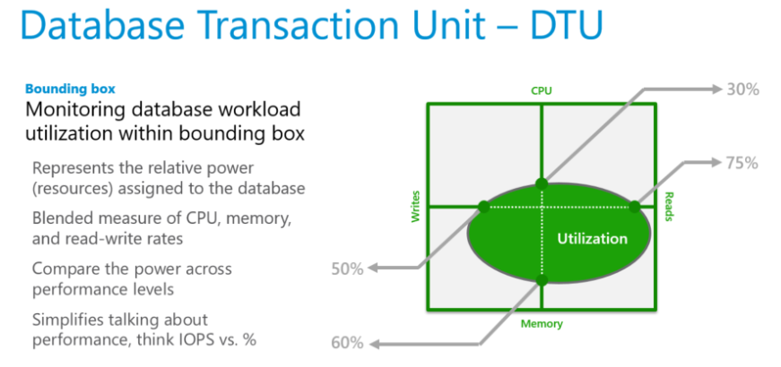
Azure Elastic Pool… Discussion on DTU before eDTU?
Before discussing eDTU, a quick understanding on DTU.
What is a DTU?
Database Transaction Unit (DTU) describes the capacity of a performance level of Basic, Standard, and Premium databases.
DTUs are based on a blended measure of CPU, Memory, Reads and Writes. As DTUs increase, the power offered by the performance level increases.
A performance level with 5 DTUs has five times more power than with 1 DTU.
DTU Quota applies to the server and not to individual database.
Each server has maximum of 1600 DTU’s.

Slide 14
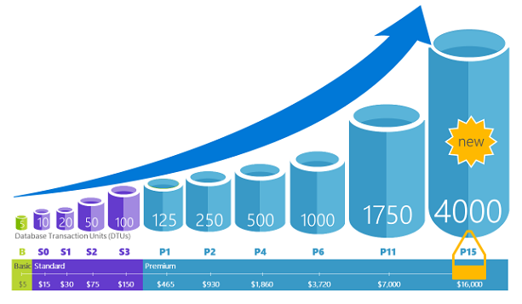
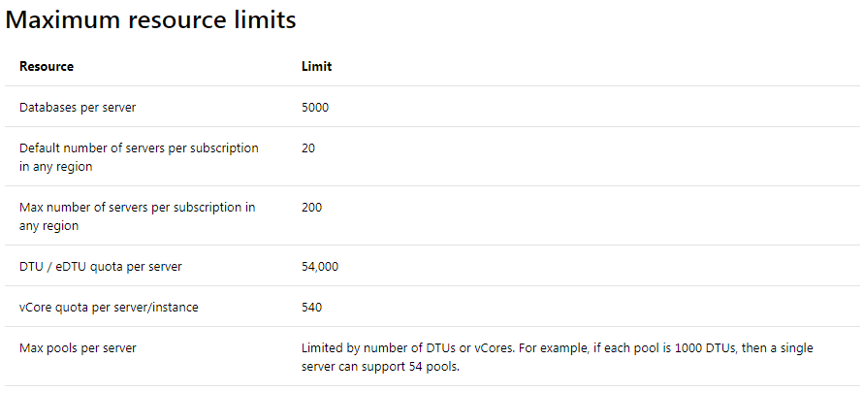
Azure Elastic Pool… DTU?
DTU across Service Tiers:
Database Transaction Unit (DTU) describes the capacity of a performance level of Basic, Standard, and Premium databases.
DTUs are based on a blended measure of CPU, Memory, Reads and Writes. As DTUs increase, the power offered by the performance level increases.
A performance level with 5 DTUs has five times more power than 1 DTU.
DTU Quota applies to the server and not to individual database.
Each server has maximum of 54,000 DTU’s.
For Updated Service Tier Information:
https://azure.microsoft.com/en-in/pricing/details/sql-database/single/

Slide 15
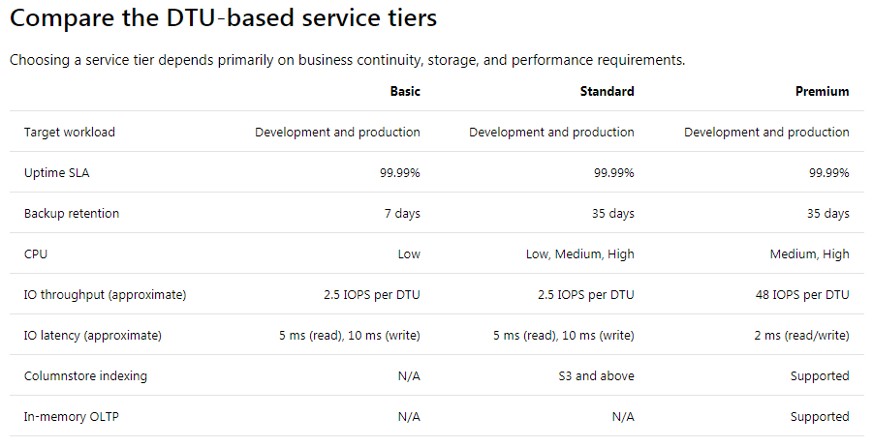
Azure Elastic Pool… DTU?

Slide 16
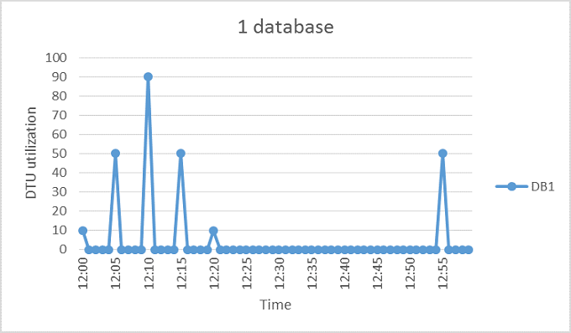
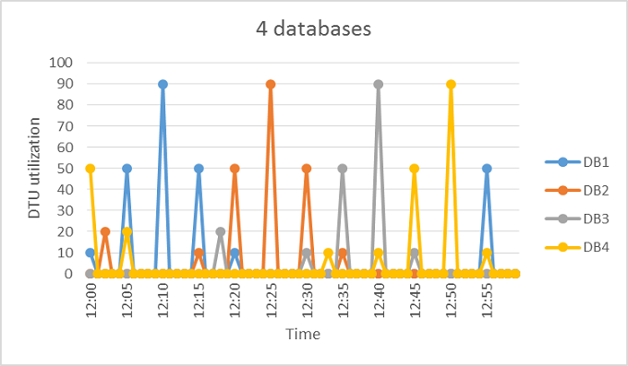
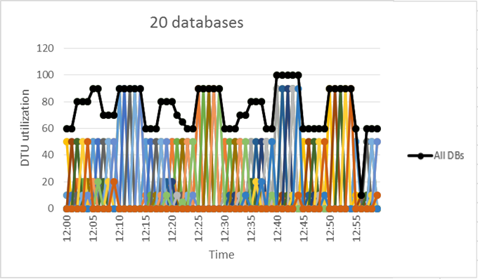
Azure Elastic Pool… Now its eDTU time?
The aggregate DTU utilization across all 20 databases is illustrated by the black line and it never exceeds 100DTU.
That means 20 databases can share 100 eDTU’s.
This results in a 20x reduction in DTUs and 13x price reduction compared to placing each of the databases in S3

Slide 17
Azure Elastic Pool… Pricing Facts of eDTU…
This example of 20 databases pooling is ideal for following reasons:
There are large differences between peak utilization and average utilization per database.
The peak utilization for each database occurs at different points in time.
eDTUs are shared between many databases.
eDTU unit price for a pool is 1.5x greater than the DTU unit price for single DB, it is so because pool eDTUs can be shared by many databases and fewer total eDTUs are needed.
At least two S3 databases or at least 15 S0 databases are needed for 100 eDTU pool to be more cost-effective.
Estimating eDTUs: (For DTU-based Purchasing Model)
MAX(<Total DBs X Avg DTU utilization per DB>, <Number of concurrently peaking DBs X Peak DTU utilization per DB>)

Slide 18


Azure Elastic Pool… Equity To Equality

Slide 19

Azure Elastic Jobs
Elastic Database jobs is a customer-hosted Azure Cloud Service that enables the execution of ad-hoc and scheduled administrative tasks, which are called jobs.
The databases in an elastic pool are on a single Azure SQL Database server and share a set number of resources at a set price.
Elastic Database jobs feature (preview) enables you to reliably execute a Transact-SQL (T-SQL) script across a group of databases, including:
Custom-defined collection of databases (explained below)
All databases in an elastic pool
A shard set

Slide 20
How do Elastic Jobs work?
How Elastic Database jobs work?
An Azure SQL Database is designated as a control database which stores all meta-data and state data. The control database is accessed by the job service to launch and track jobs to execute.
Two different roles communicate with the control database:
Controller: Determines which jobs require tasks to run jobs, and retries failed jobs by creating new job tasks.
Job Task Execution: Carries out the job tasks.

Slide 21
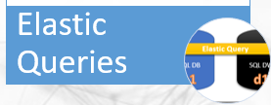
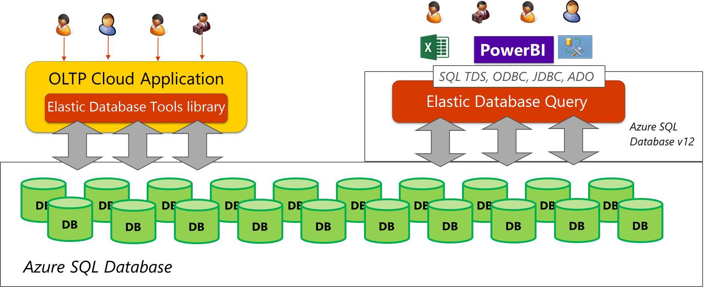
Azure Elastic Queries
The elastic query feature (preview) enables you to run a Transact-SQL query that spans multiple databases in Azure SQL Database.
It allows to perform cross-database queries to access remote tables, and to connect Microsoft and third-party tools (Excel, Power BI, Tableau, etc.) to query across data tiers with multiple databases.
Reasons to Use Elastic Queries:
Azure SQL Database: Query across Azure SQL databases completely in T-SQL. This allows for read-only querying of remote databases
Available on standard tier: Elastic query is supported on both the Standard and Premium service tiers.

Slide 22
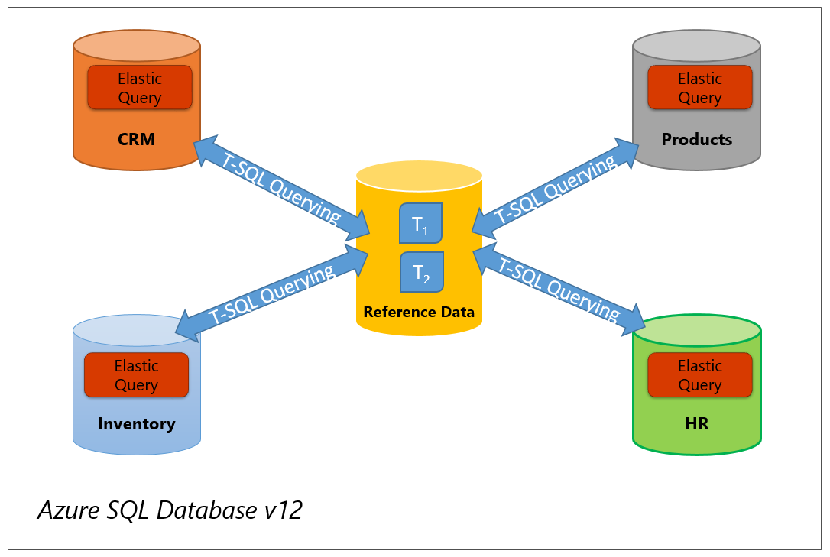
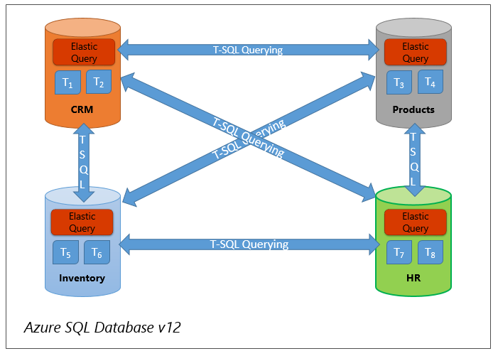
Customer Scenarios for Elastic Queries:
Customer scenario topologies:
Vertical partitioning - Cross-database queries (Topology 1): The data is partitioned vertically between a number of databases in a data tier. Typically, different sets of tables reside on different databases. That means that the schema is different on different databases. For instance, all tables for inventory are on one database while all accounting-related tables are on a second database.
Vertical Partitioning querying with reference data
Vertical Partitioning – querying across databases

Slide 23
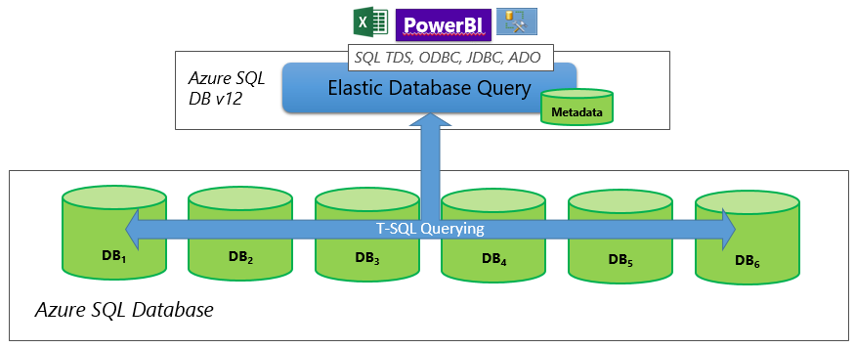
Customer Scenarios for Elastic Queries:
Customer scenario topologies:
Horizontal Partitioning - Sharding (Topology 2): Data is partitioned horizontally to distribute rows across a scaled out data tier. With this approach, the schema is identical on all participating databases. This approach is also called “sharding”.
Sharding can be performed and managed using (1) the elastic database tools libraries or (2) self-sharding. An elastic query is used to query or compile reports across many shards.

Slide 24

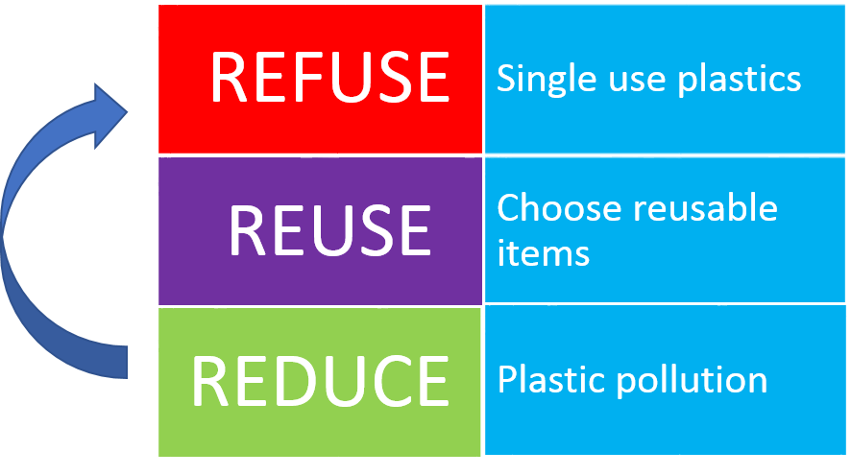
Please Don’t Forget your 3 giveaways on Plastic

